Slide 1
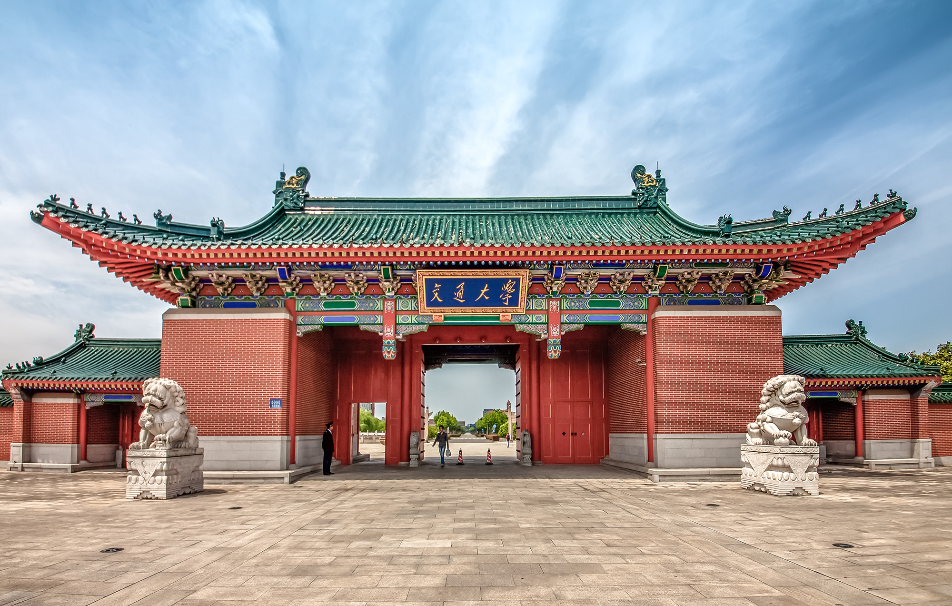
时间最优的速度规划问题
Minimum-time Speed Optimization
隋思哲
2020年12月14日

Slide 2

1
问题陈述
2
算法框架
3
环境及约束
4
实验

Slide 3
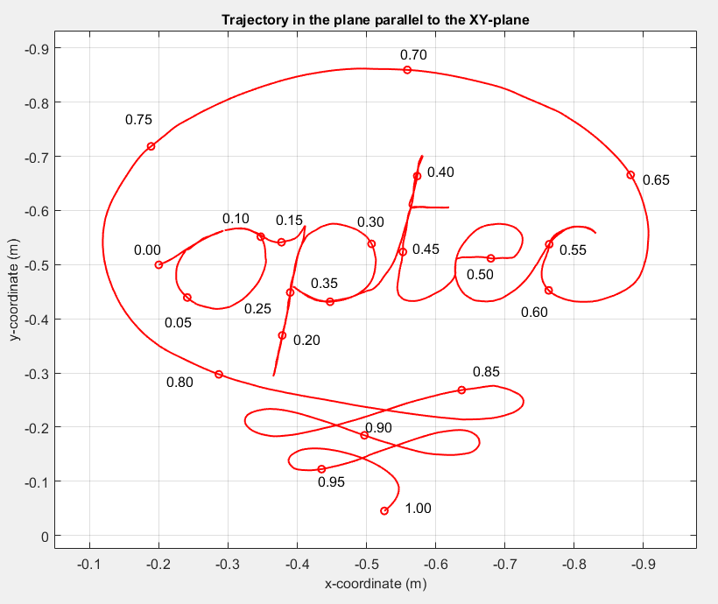
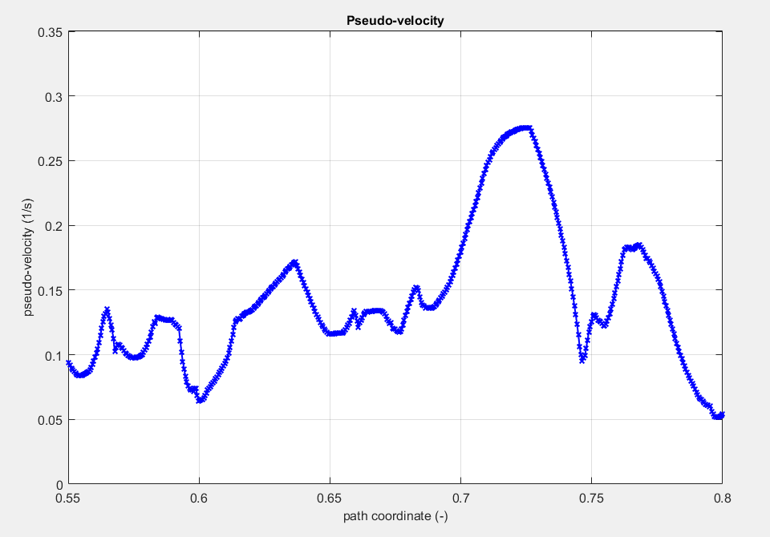

确定轨迹的时间最优速度规划问题
已知轨迹$q∈R^{p}$，求解能最小化轨迹遍历时间的控制输入/“速度”曲线
以怎样的“速度”通过每一个点，能在满足约束的条件下，尽可能地缩短通行时间
时间最优
满足约束
已知
求解

Slide 4
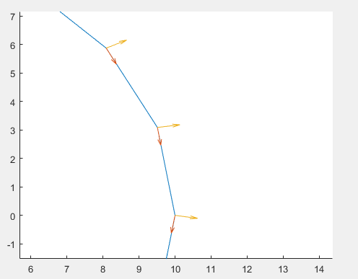
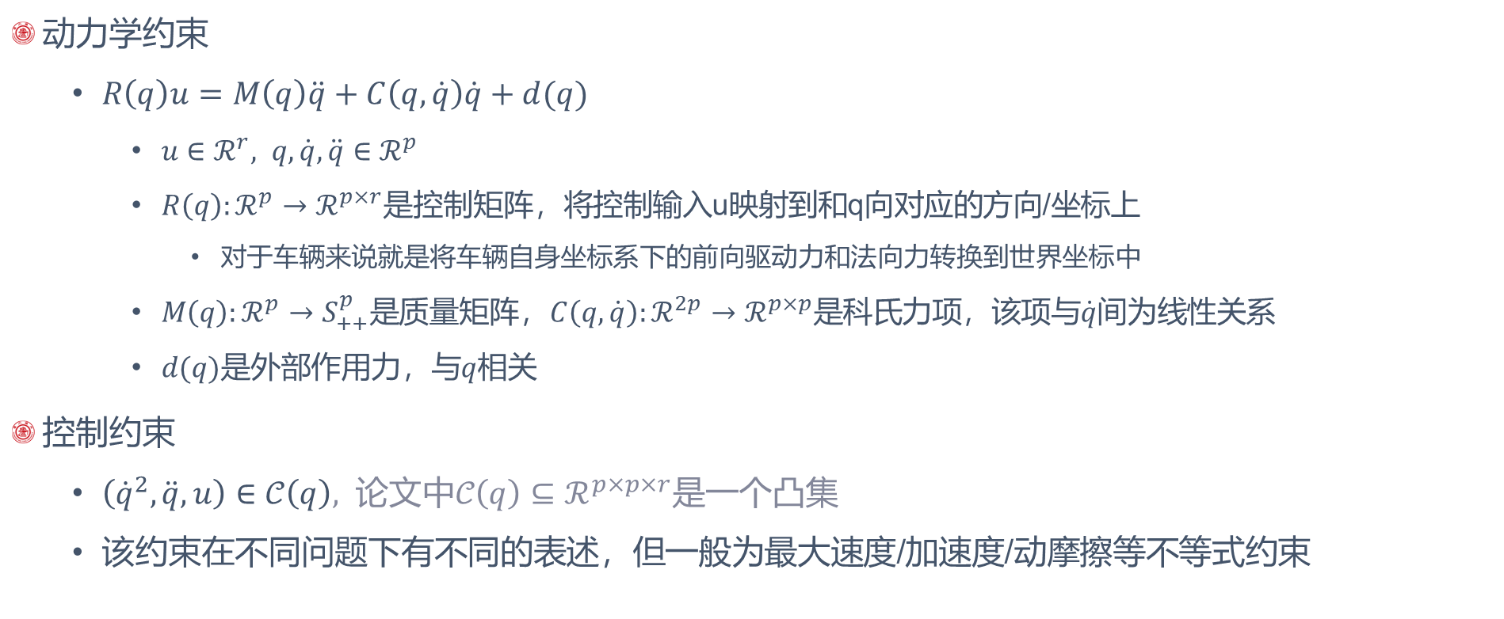

约束条件
动力学约束
$R\left(q\right)u=M\left(q\right)\ddot{q}+C\left(q,\dot{q}\right)\dot{q}+d(q)$
$u∈ℛ^{r}, q,\dot{q},\ddot{q}∈ℛ^{p}$
$R\left(q\right):ℛ^{p}→ℛ^{p×r}$是控制矩阵，将控制输入u映射到和q向对应的方向/坐标上
对于车辆来说就是将车辆自身坐标系下的前向驱动力和法向力转换到世界坐标中
$M\left(q\right):ℛ^{p}→S_{++}^{p}是$质量矩阵，$C\left(q,\dot{q}\right):ℛ^{2p}→ℛ^{p×p}是$科氏力项，该项与$\dot{q}间$为线性关系
$d(q)是$外部作用力，与$q$相关
控制约束
$\left({\dot{q}}^{2},\ddot{q},u\right)∈𝒞\left(q\right), 论文中𝒞\left(q\right)⊆ℛ^{p×p×r}$是一个凸集
该约束在不同问题下有不同的表述，但一般为最大速度/加速度/动摩擦等不等式约束

Slide 5
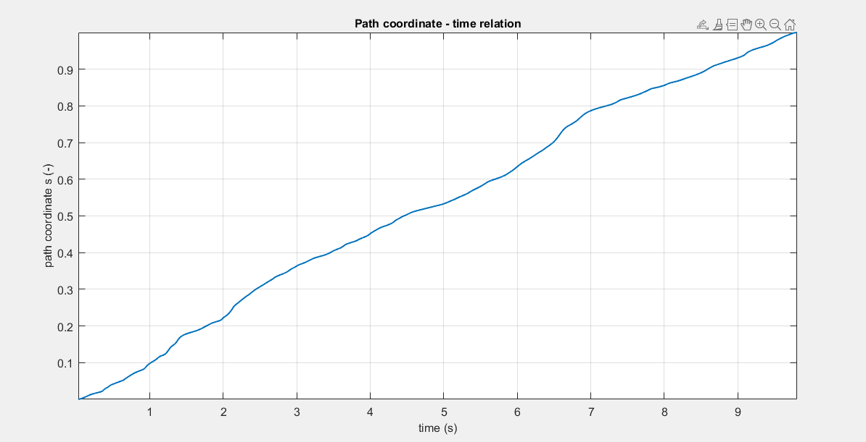
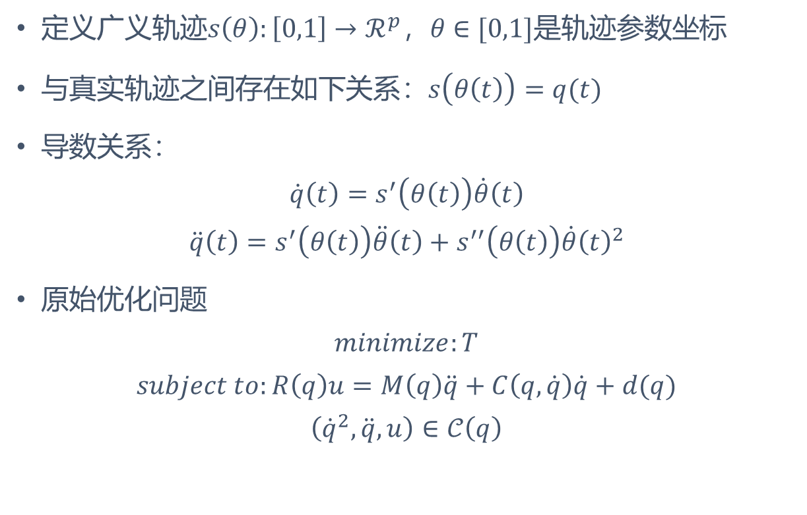

轨迹的参数化描述
定义广义轨迹$s\left(θ\right):\left[0,1\right]→ℛ^{p}，θ∈[0,1]是$轨迹参数坐标
与真实轨迹之间存在如下关系：$s\left(θ\left(t\right)\right)=q(t)$
导数关系：
$$\dot{q}\left(t\right)=s^{′}\left(θ\left(t\right)\right)\dot{θ}\left(t\right)$$
$$\ddot{q}\left(t\right)=s^{′}\left(θ\left(t\right)\right)\ddot{θ}\left(t\right)+s^{′′}\left(θ\left(t\right)\right)\dot{θ}{\left(t\right)}^{2}$$
原始优化问题
$$minimize:T$$
$$subject to:R\left(q\right)u=M\left(q\right)\ddot{q}+C\left(q,\dot{q}\right)\dot{q}+d(q)$$
$$\left({\dot{q}}^{2},\ddot{q},u\right)∈𝒞\left(q\right)$$
$$θ\left(t\right)−t曲线$$

Slide 6
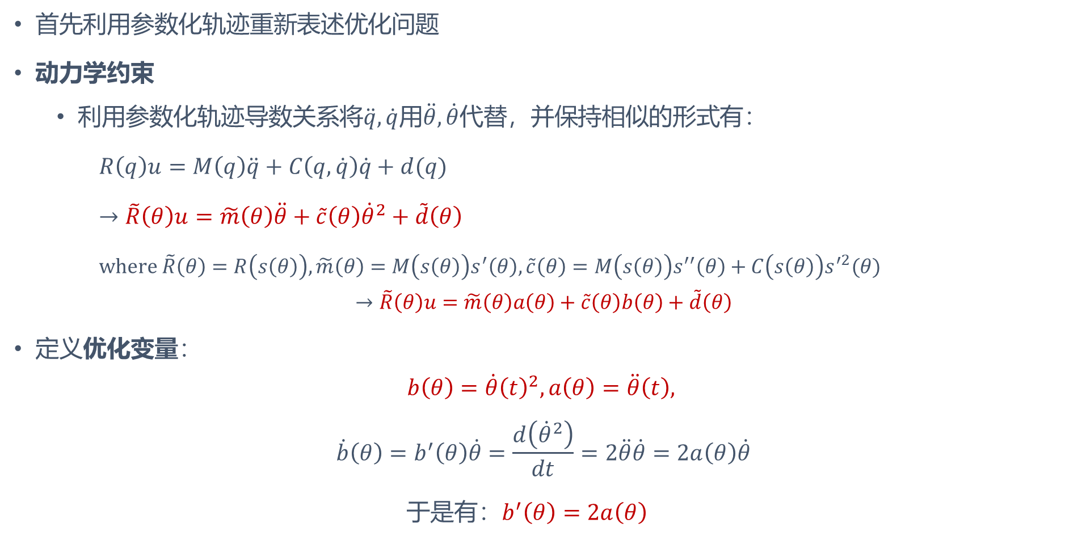
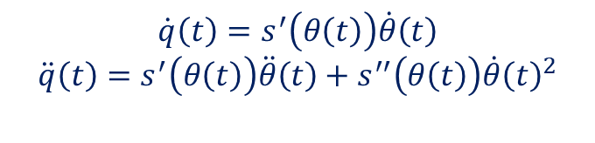
凸优化问题的描述
首先利用参数化轨迹重新表述优化问题
动力学约束
利用参数化轨迹导数关系将$\ddot{q},\dot{q}用\ddot{θ},\dot{θ}$代替，并保持相似的形式有：
$R\left(q\right)u=M\left(q\right)\ddot{q}+C\left(q,\dot{q}\right)\dot{q}+d(q)$
$→\tilde{R}\left(θ\right)u=\tilde{m}\left(θ\right)\ddot{θ}+\tilde{c}\left(θ\right){\dot{θ}}^{2}+\tilde{d}\left(θ\right)$
$where \tilde{R}\left(θ\right)=R\left(s\left(θ\right)\right), \tilde{m}\left(θ\right)=M\left(s\left(θ\right)\right)s^{′}\left(θ\right),\tilde{c}\left(θ\right)=M\left(s\left(θ\right)\right)s^{′′}\left(θ\right)+C\left(s\left(θ\right)\right)s^{′2}(θ)$
$$→\tilde{R}\left(θ\right)u=\tilde{m}\left(θ\right)a\left(θ\right)+\tilde{c}\left(θ\right)b\left(θ\right)+\tilde{d}\left(θ\right)$$
定义优化变量：
$$b\left(θ\right)=\dot{θ}{\left(t\right)}^{2},a\left(θ\right)=\ddot{θ}\left(t\right),$$
$$\dot{b}\left(θ\right)=b^{′}\left(θ\right)\dot{θ}=\frac{d\left({\dot{θ}}^{2}\right)}{dt}=2\ddot{θ}\dot{θ}=2a\left(θ\right)\dot{θ}$$
于是有：$b^{′}\left(θ\right)=2a\left(θ\right)$
$$\dot{q}\left(t\right)=s^{′}\left(θ\left(t\right)\right)\dot{θ}\left(t\right)$$
$$\ddot{q}\left(t\right)=s^{′}\left(θ\left(t\right)\right)\ddot{θ}\left(t\right)+s^{′′}\left(θ\left(t\right)\right)\dot{θ}{\left(t\right)}^{2}$$

Slide 7
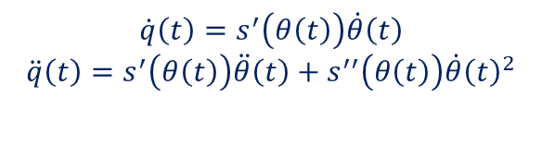
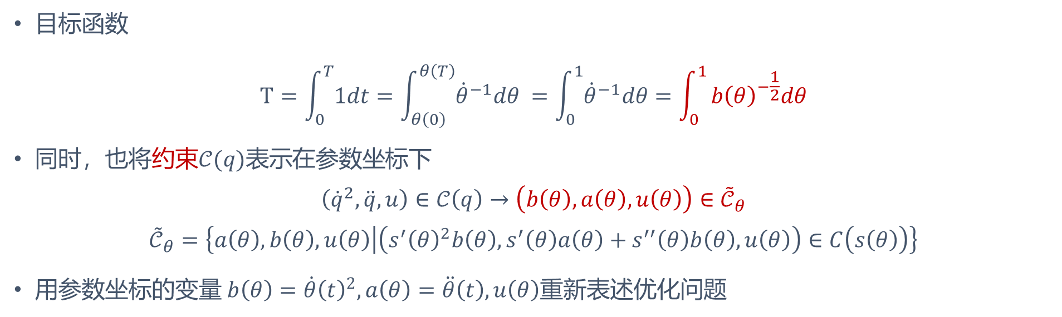
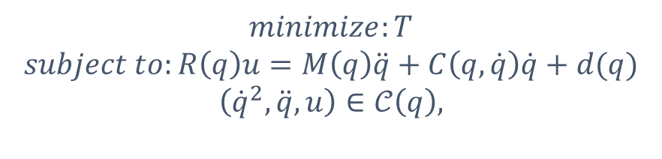
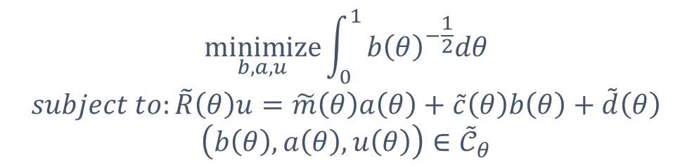
凸优化问题的描述
目标函数
$$T=\int_{0}^{T}{1dt}=\int_{θ\left(0\right)}^{θ\left(T\right)}{{\dot{θ}}^{−1}dθ }=\int_{0}^{1}{{\dot{θ}}^{−1}dθ}=\int_{0}^{1}{b{\left(θ\right)}^{−\frac{1}{2}}dθ}$$
同时，也将约束$𝒞(q)表示$在参数坐标下
$$\left({\dot{q}}^{2},\ddot{q},u\right)∈𝒞\left(q\right)→\left(b\left(θ\right),a\left(θ\right),u\left(θ\right)\right)∈{\tilde{𝒞}}_{θ}$$
$${\tilde{𝒞}}_{θ}=\left\{a\left(θ\right),b\left(θ\right),u\left(θ\right) | \left(s^{′}{\left(θ\right)}^{2}b\left(θ\right),s^{′}\left(θ\right)a\left(θ\right)+s^{′′}\left(θ\right)b\left(θ\right),u\left(θ\right)\right)∈C\left(s\left(θ\right)\right)\right\}$$
用参数坐标的变量 $b\left(θ\right)=\dot{θ}{\left(t\right)}^{2},a\left(θ\right)=\ddot{θ}\left(t\right),u\left(θ\right)$重新表述优化问题
$$\dot{q}\left(t\right)=s^{′}\left(θ\left(t\right)\right)\dot{θ}\left(t\right)$$
$$\ddot{q}\left(t\right)=s^{′}\left(θ\left(t\right)\right)\ddot{θ}\left(t\right)+s^{′′}\left(θ\left(t\right)\right)\dot{θ}{\left(t\right)}^{2}$$
$$\underset{b,a,u}{minimize}{\int_{0}^{1}{b{\left(θ\right)}^{−\frac{1}{2}}dθ}}$$
$$subject to:\tilde{R}\left(θ\right)u=\tilde{m}\left(θ\right)a\left(θ\right)+\tilde{c}\left(θ\right)b\left(θ\right)+\tilde{d}\left(θ\right)$$
$$\left(b\left(θ\right),a\left(θ\right),u\left(θ\right)\right)∈{\tilde{𝒞}}_{θ}$$
$$minimize:T$$
$$subject to:R\left(q\right)u=M\left(q\right)\ddot{q}+C\left(q,\dot{q}\right)\dot{q}+d(q)$$
$$\left({\dot{q}}^{2},\ddot{q},u\right)∈𝒞\left(q\right),$$

Slide 8
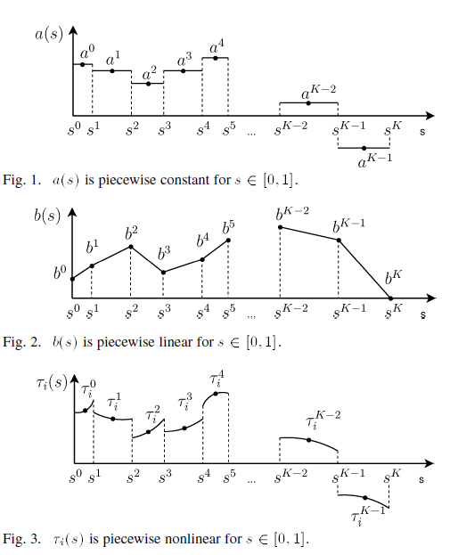
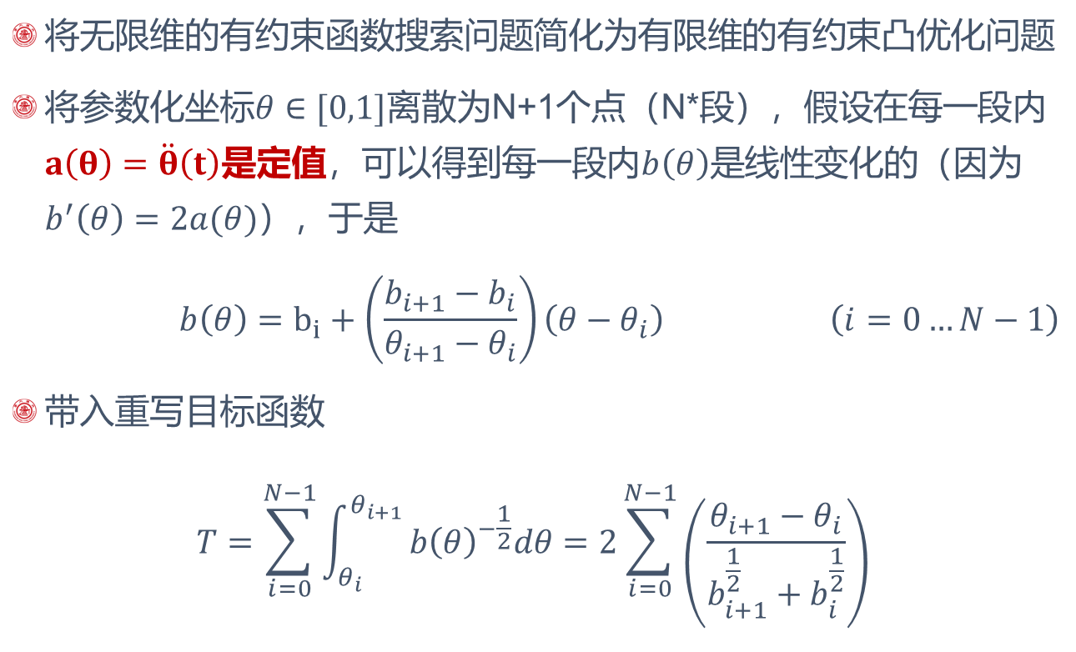
离散化
将无限维的有约束函数搜索问题简化为有限维的有约束凸优化问题
将参数化坐标$θ∈[0,1]$离散为N+1个点（N*段），假设在每一段内$a\left(θ\right)=\ddot{θ}\left(t\right)$是定值，可以得到每一段内$b\left(θ\right)是$线性变化的（因为$b^{′}\left(θ\right)=2a(θ)）$，于是
$$\begin{aligned} b\left(θ\right)=b_{i}+\left(\frac{b_{i+1}−b_{i}}{θ_{i+1}−θ_{i}}\right)\left(θ−θ_{i}\right) \#\left(i=0…N−1\right)\end{aligned}$$
带入重写目标函数
$$T=\sum_{i=0}^{N−1}{\int_{θ_{i}}^{θ_{i+1}}{b{\left(θ\right)}^{−\frac{1}{2}}dθ}}=2\sum_{i=0}^{N−1}{\left(\frac{θ_{i+1}−θ_{i}}{b_{i+1}^{\frac{1}{2}}+b_{i}^{\frac{1}{2}}}\right)}$$
N需要足够大来保证在分割点处的$q′′(s)$是近似准确的“加速度”
N确定之后$θ_{i}$的值也被确定

Slide 9
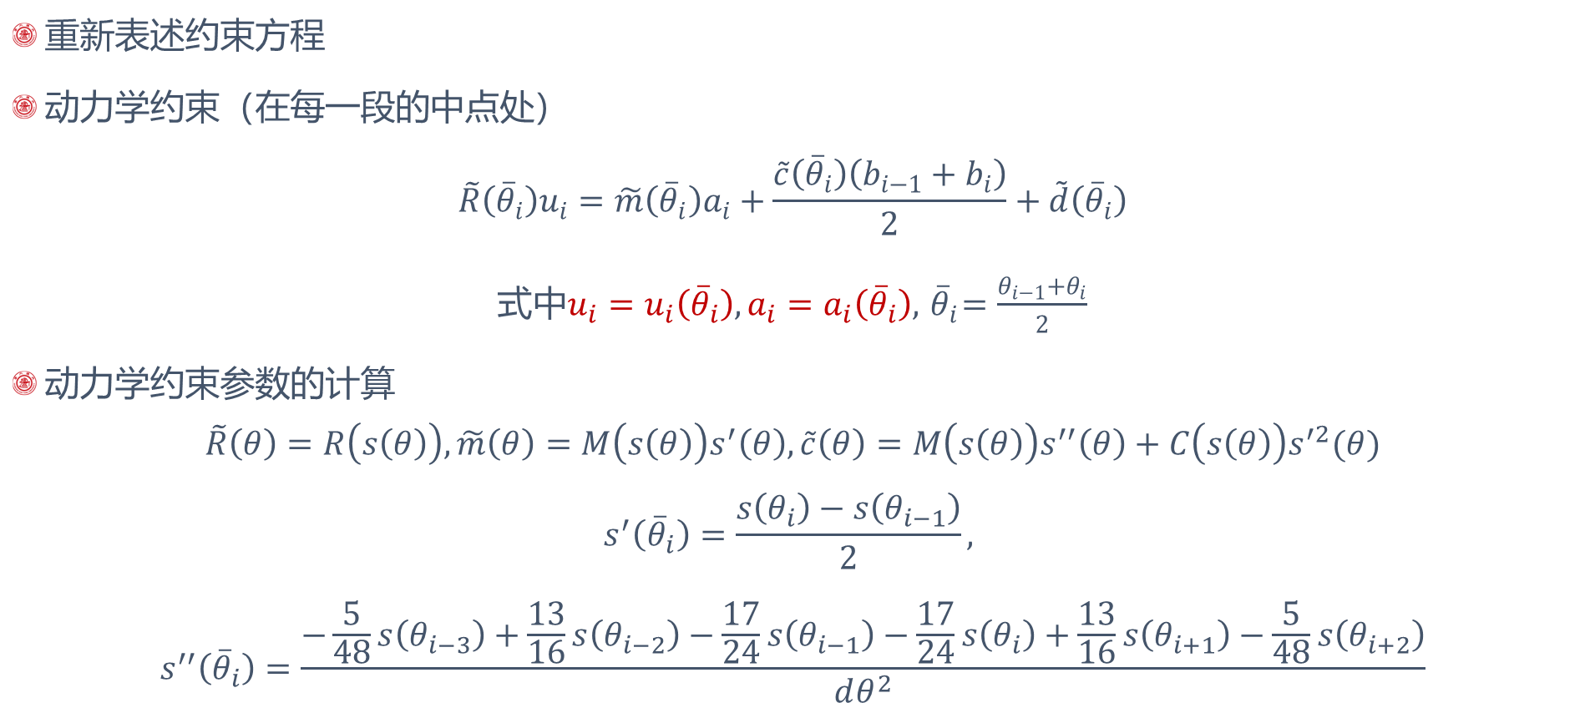
离散化
重新表述约束方程
动力学约束（在每一段的中点处）
$$\tilde{R}\left({\overline{θ}}_{i}\right)u_{i}=\tilde{m}\left({\overline{θ}}_{i}\right)a_{i}+\frac{\tilde{c}\left({\overline{θ}}_{i}\right)\left(b_{i−1}+b_{i}\right)}{2}+\tilde{d}\left({\overline{θ}}_{i}\right)$$
式中$u_{i}=u_{i}\left({\overline{θ}}_{i}\right),a_{i}=a_{i}\left({\overline{θ}}_{i}\right),{ \overline{θ}}_{i}=\frac{θ_{i−1}+θ_{i}}{2}$
动力学约束参数的计算
$$\tilde{R}\left(θ\right)=R\left(s\left(θ\right)\right), \tilde{m}\left(θ\right)=M\left(s\left(θ\right)\right)s^{′}\left(θ\right),\tilde{c}\left(θ\right)=M\left(s\left(θ\right)\right)s^{′′}\left(θ\right)+C\left(s\left(θ\right)\right)s^{′2}(θ)$$
$$s^{′}\left({\overline{θ}}_{i}\right)=\frac{s\left(θ_{i}\right)−s\left(θ_{i−1}\right)}{2},$$
$$s^{′′}\left({\overline{θ}}_{i}\right)=\frac{−\frac{5}{48}s\left(θ_{i−3}\right)+\frac{13}{16}s\left(θ_{i−2}\right)−\frac{17}{24}s\left(θ_{i−1}\right)−\frac{17}{24}s\left(θ_{i}\right)+\frac{13}{16}s\left(θ_{i+1}\right)−\frac{5}{48}s\left(θ_{i+2}\right)}{dθ^{2}}$$
$b_{i}定义在$N+1个端点上，$u_{i},a_{i}$定义在每段的中点

Slide 10
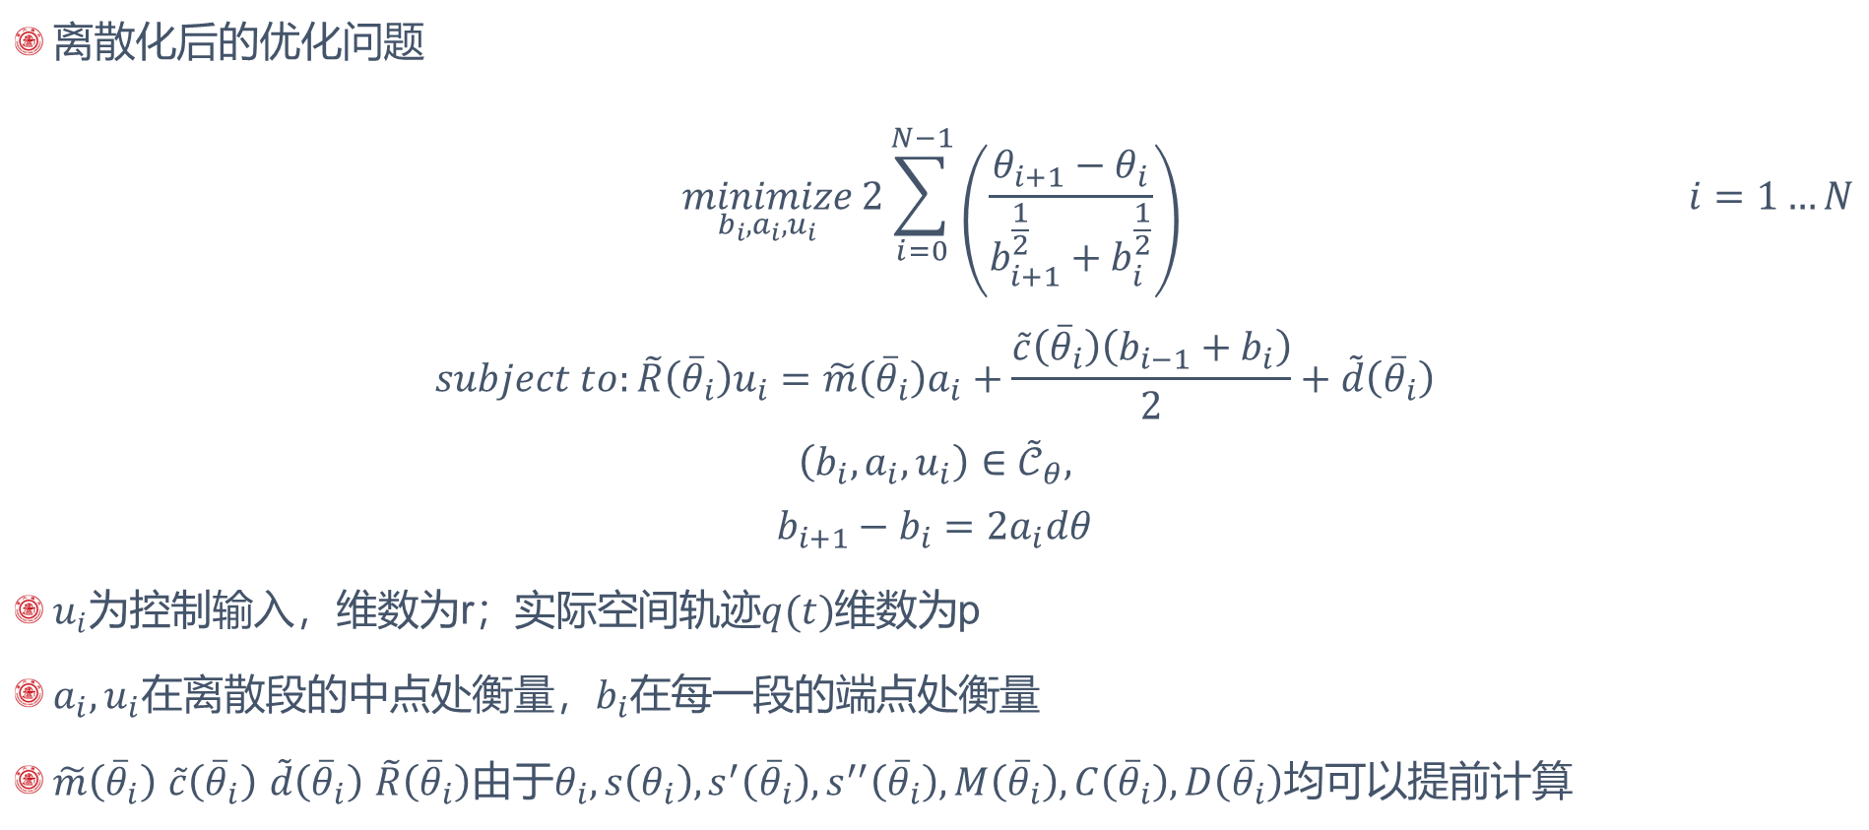
离散化
离散化后的优化问题
$$\begin{aligned} \underset{b_{i},a_{i},u_{i}}{minimize}{2\sum_{i=0}^{N−1}{\left(\frac{θ_{i+1}−θ_{i}}{b_{i+1}^{\frac{1}{2}}+b_{i}^{\frac{1}{2}}}\right)}} \#i=1…N\end{aligned}$$
$$subject to:\tilde{R}\left({\overline{θ}}_{i}\right)u_{i}=\tilde{m}\left({\overline{θ}}_{i}\right)a_{i}+\frac{\tilde{c}\left({\overline{θ}}_{i}\right)\left(b_{i−1}+b_{i}\right)}{2}+\tilde{d}\left({\overline{θ}}_{i}\right)$$
$$\left(b_{i},a_{i},u_{i}\right)∈{\tilde{𝒞}}_{θ},$$
$$b_{i+1}−b_{i}=2a_{i}dθ$$
$u_{i}$为控制输入，维数为r；实际空间轨迹$q(t)$维数为p
$a_{i},u_{i}$在离散段的中点处衡量，$b_{i}$在每一段的端点处衡量
$\tilde{m}\left({\overline{θ}}_{i}\right)$ $\tilde{c}\left({\overline{θ}}_{i}\right)$ $\tilde{d}\left({\overline{θ}}_{i}\right)$ $\tilde{R}\left({\overline{θ}}_{i}\right)$由于$θ_{i},s\left(θ_{i}\right),s^{′}\left({\overline{θ}}_{i}\right),s^{′′}\left({\overline{θ}}_{i}\right),M\left({\overline{θ}}_{i}\right),C\left({\overline{θ}}_{i}\right),D\left({\overline{θ}}_{i}\right)$均可以提前计算

Slide 11
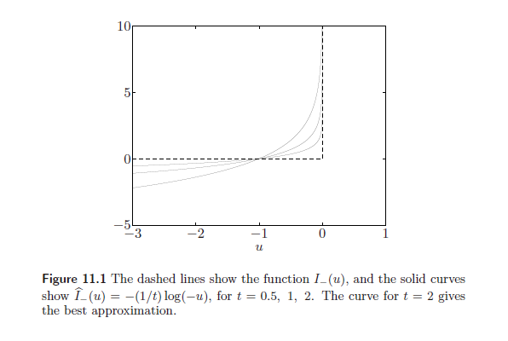
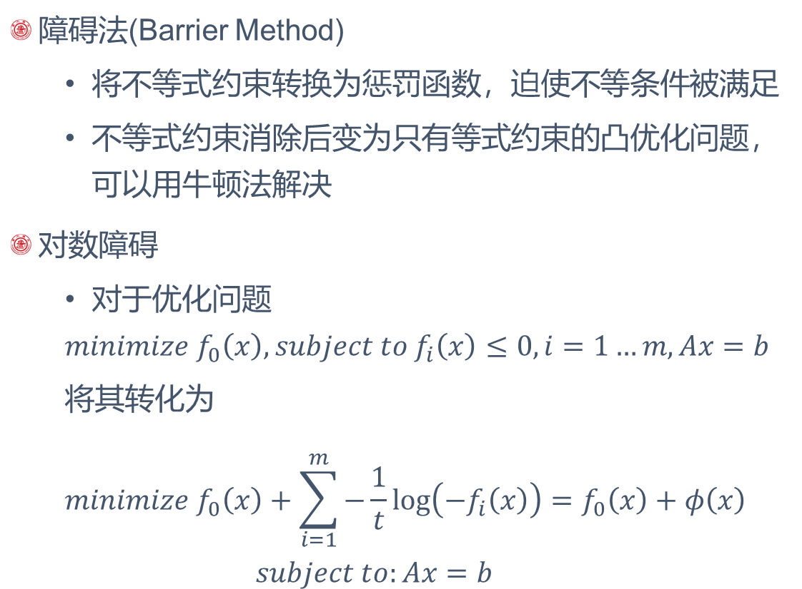
对数障碍内点法
障碍法(Barrier Method)
将不等式约束转换为惩罚函数，迫使不等条件被满足
不等式约束消除后变为只有等式约束的凸优化问题，可以用牛顿法解决
对数障碍
对于优化问题
$$minimize f_{0}\left(x\right), subject to f_{i}\left(x\right)≤0,i=1…m, Ax=b$$
将其转化为
$$minimize f_{0}\left(x\right)+\sum_{i=1}^{m}{−\frac{1}{t}\log\left(−f_{i}\left(x\right)\right)}=f_{0}\left(x\right)+φ\left(x\right)$$
$$subject to:Ax=b$$

Slide 12
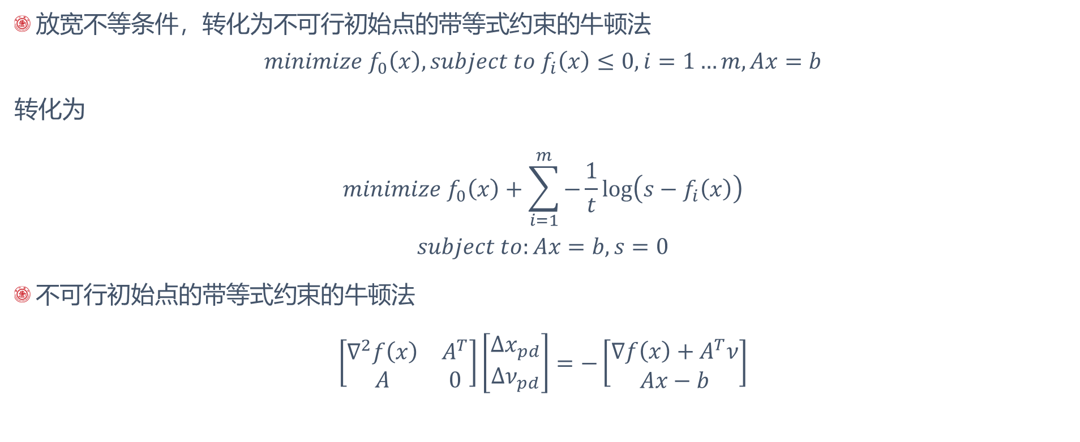
不可行初始点的对数障碍内点法
放宽不等条件，转化为不可行初始点的带等式约束的牛顿法
$$minimize f_{0}\left(x\right), subject to f_{i}\left(x\right)≤0,i=1…m, Ax=b$$
转化为
$$minimize f_{0}\left(x\right)+\sum_{i=1}^{m}{−\frac{1}{t}\log\left(s−f_{i}\left(x\right)\right)}$$
$$subject to:Ax=b,s=0$$
不可行初始点的带等式约束的牛顿法
$$\left[\begin{matrix}∇^{2}f\left(x\right) & A^{T} \\ A & 0\end{matrix}\right]\left[\begin{matrix}Δx_{pd} \\ Δν_{pd}\end{matrix}\right]=−\left[\begin{matrix}∇f\left(x\right)+A^{T}ν \\ Ax−b\end{matrix}\right]$$

Slide 13
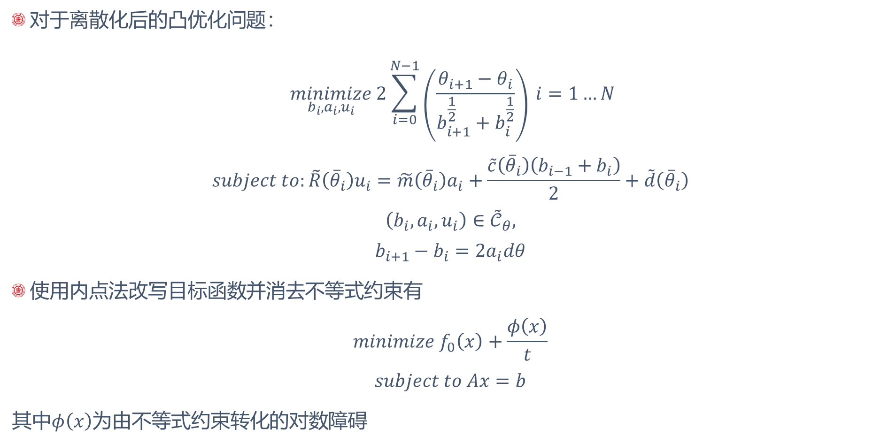
论文算法
对于离散化后的凸优化问题：
$$\begin{aligned} \underset{b_{i},a_{i},u_{i}}{minimize}{2\sum_{i=0}^{N−1}{\left(\frac{θ_{i+1}−θ_{i}}{b_{i+1}^{\frac{1}{2}}+b_{i}^{\frac{1}{2}}}\right)}} \#i=1…N\end{aligned}$$
$$subject to:\tilde{R}\left({\overline{θ}}_{i}\right)u_{i}=\tilde{m}\left({\overline{θ}}_{i}\right)a_{i}+\frac{\tilde{c}\left({\overline{θ}}_{i}\right)\left(b_{i−1}+b_{i}\right)}{2}+\tilde{d}\left({\overline{θ}}_{i}\right)$$
$$\left(b_{i},a_{i},u_{i}\right)∈{\tilde{𝒞}}_{θ},$$
$$b_{i+1}−b_{i}=2a_{i}dθ$$
使用内点法改写目标函数并消去不等式约束有
$$minimize f_{0}\left(x\right)+\frac{φ\left(x\right)}{t}$$
$$subject to Ax=b$$
其中$φ\left(x\right)$为由不等式约束转化的对数障碍

Slide 14
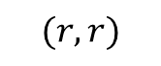
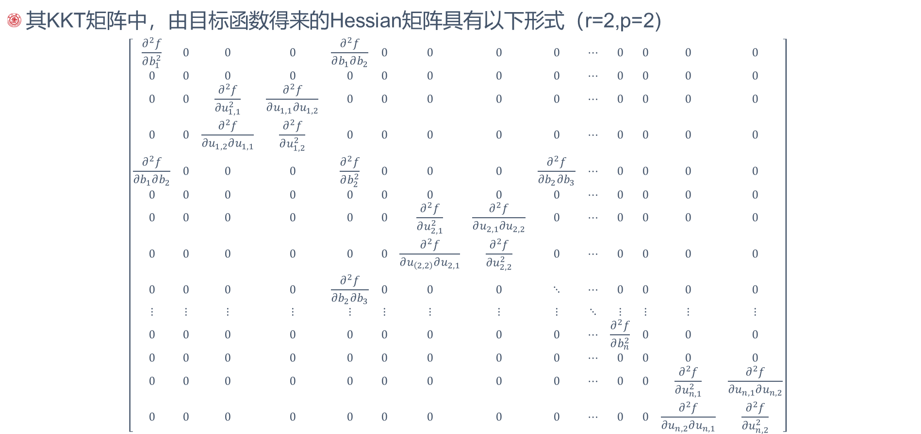
论文算法
其KKT矩阵中，由目标函数得来的Hessian矩阵具有以下形式（r=2,p=2)
$$\left[\begin{matrix}\frac{∂^{2}f}{∂b_{1}^{2}} & 0 & 0 & 0 & \frac{∂^{2}f}{∂b_{1}∂b_{2}} & 0 & 0 & 0 & 0 & ⋯ & 0 & 0 & 0 & 0 \\ 0 & 0 & 0 & 0 & 0 & 0 & 0 & 0 & 0 & ⋯ & 0 & 0 & 0 & 0 \\ 0 & 0 & \frac{∂^{2}f}{∂u_{1,1}^{2}} & \frac{∂^{2}f}{∂u_{1,1}∂u_{1,2}} & 0 & 0 & 0 & 0 & 0 & ⋯ & 0 & 0 & 0 & 0 \\ 0 & 0 & \frac{∂^{2}f}{∂u_{1,2}∂u_{1,1}} & \frac{∂^{2}f}{∂u_{1,2}^{2}} & 0 & 0 & 0 & 0 & 0 & ⋯ & 0 & 0 & 0 & 0 \\ \frac{∂^{2}f}{∂b_{1}∂b_{2}} & 0 & 0 & 0 & \frac{∂^{2}f}{∂b_{2}^{2}} & 0 & 0 & 0 & \frac{∂^{2}f}{∂b_{2}∂b_{3}} & ⋯ & 0 & 0 & 0 & 0 \\ 0 & 0 & 0 & 0 & 0 & 0 & 0 & 0 & 0 & ⋯ & 0 & 0 & 0 & 0 \\ 0 & 0 & 0 & 0 & 0 & 0 & \frac{∂^{2}f}{∂u_{2,1}^{2}} & \frac{∂^{2}f}{∂u_{2,1}∂u_{2,2}} & 0 & ⋯ & 0 & 0 & 0 & 0 \\ 0 & 0 & 0 & 0 & 0 & 0 & \frac{∂^{2}f}{∂u_{\left(2,2\right)}∂u_{2,1}} & \frac{∂^{2}f}{∂u_{2,2}^{2}} & 0 & ⋯ & 0 & 0 & 0 & 0 \\ 0 & 0 & 0 & 0 & \frac{∂^{2}f}{∂b_{2}∂b_{3}} & 0 & 0 & 0 & ⋱ & ⋯ & 0 & 0 & 0 & 0 \\ ⋮ & ⋮ & ⋮ & ⋮ & ⋮ & ⋮ & ⋮ & ⋮ & ⋮ & ⋱ & ⋮ & ⋮ & ⋮ & ⋮ \\ 0 & 0 & 0 & 0 & 0 & 0 & 0 & 0 & 0 & ⋯ & \frac{∂^{2}f}{∂b_{n}^{2}} & 0 & 0 & 0 \\ 0 & 0 & 0 & 0 & 0 & 0 & 0 & 0 & 0 & ⋯ & 0 & 0 & 0 & 0 \\ 0 & 0 & 0 & 0 & 0 & 0 & 0 & 0 & 0 & ⋯ & 0 & 0 & \frac{∂^{2}f}{∂u_{n,1}^{2}} & \frac{∂^{2}f}{∂u_{n,1}∂u_{n,2}} \\ 0 & 0 & 0 & 0 & 0 & 0 & 0 & 0 & 0 & ⋯ & 0 & 0 & \frac{∂^{2}f}{∂u_{n,2}∂u_{n,1}} & \frac{∂^{2}f}{∂u_{n,2}^{2}}\end{matrix}\right]$$
$$(r,r)$$

Slide 15
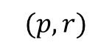
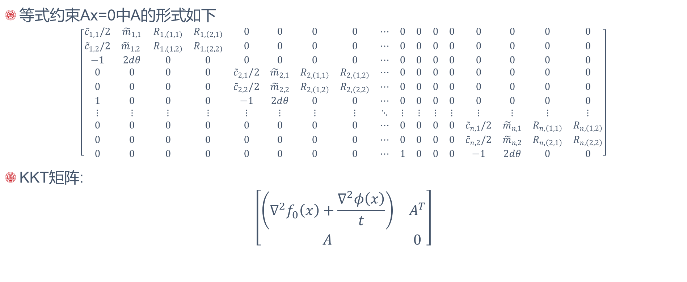
论文算法
等式约束Ax=0中A的形式如下
$$\left[\begin{matrix}{\tilde{c}}_{1,1}/2 & {\tilde{m}}_{1,1} & R_{1,\left(1,1\right)} & R_{1,\left(2,1\right)} & 0 & 0 & 0 & 0 & ⋯ & 0 & 0 & 0 & 0 & 0 & 0 & 0 & 0 \\ {\tilde{c}}_{1,2}/2 & {\tilde{m}}_{1,2} & R_{1,\left(1,2\right)} & R_{1,\left(2,2\right)} & 0 & 0 & 0 & 0 & ⋯ & 0 & 0 & 0 & 0 & 0 & 0 & 0 & 0 \\ −1 & 2dθ & 0 & 0 & 0 & 0 & 0 & 0 & ⋯ & 0 & 0 & 0 & 0 & 0 & 0 & 0 & 0 \\ 0 & 0 & 0 & 0 & {\tilde{c}}_{2,1}/2 & {\tilde{m}}_{2,1} & R_{2,\left(1,1\right)} & R_{2,\left(1,2\right)} & ⋯ & 0 & 0 & 0 & 0 & 0 & 0 & 0 & 0 \\ 0 & 0 & 0 & 0 & {\tilde{c}}_{2,2}/2 & {\tilde{m}}_{2,2} & R_{2,\left(1,2\right)} & R_{2,\left(2,2\right)} & ⋯ & 0 & 0 & 0 & 0 & 0 & 0 & 0 & 0 \\ 1 & 0 & 0 & 0 & −1 & 2dθ & 0 & 0 & ⋯ & 0 & 0 & 0 & 0 & 0 & 0 & 0 & 0 \\ ⋮ & ⋮ & ⋮ & ⋮ & ⋮ & ⋮ & ⋮ & ⋮ & ⋱ & ⋮ & ⋮ & ⋮ & ⋮ & ⋮ & ⋮ & ⋮ & ⋮ \\ 0 & 0 & 0 & 0 & 0 & 0 & 0 & 0 & ⋯ & 0 & 0 & 0 & 0 & {\tilde{c}}_{n,1}/2 & {\tilde{m}}_{n,1} & R_{n,\left(1,1\right)} & R_{n,\left(1,2\right)} \\ 0 & 0 & 0 & 0 & 0 & 0 & 0 & 0 & ⋯ & 0 & 0 & 0 & 0 & {\tilde{c}}_{n,2}/2 & {\tilde{m}}_{n,2} & R_{n,\left(2,1\right)} & R_{n,\left(2,2\right)} \\ 0 & 0 & 0 & 0 & 0 & 0 & 0 & 0 & ⋯ & 1 & 0 & 0 & 0 & −1 & 2dθ & 0 & 0\end{matrix}\right]$$
KKT矩阵:
$$\left[\begin{matrix}\left(∇^{2}f_{0}\left(x\right)+\frac{∇^{2}φ\left(x\right)}{t}\right) & A^{T} \\ A & 0\end{matrix}\right]$$
$$(p,r)$$

Slide 16
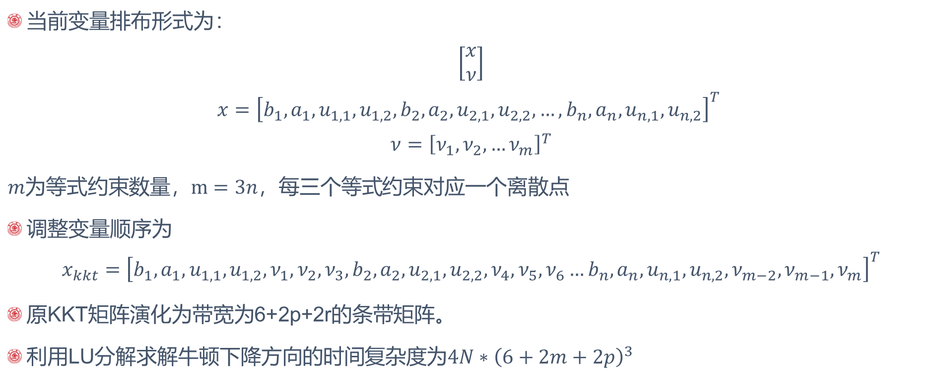
论文算法
当前变量排布形式为：
$$\left[\begin{matrix}x \\ ν\end{matrix}\right]$$
$$x={\left[b_{1},a_{1},u_{1,1},u_{1,2},b_{2},a_{2},u_{2,1},u_{2,2},…,b_{n},a_{n},u_{n,1},u_{n,2}\right]}^{T}$$
$$ν={\left[ν_{1},ν_{2},…ν_{m}\right]}^{T}$$
$m为等式\text{约束数量}，m=3n，每三个等式$约束对应一个离散点
调整变量顺序为
$$x_{kkt}={\left[b_{1},a_{1},u_{1,1},u_{1,2},ν_{1},ν_{2},ν_{3},b_{2},a_{2},u_{2,1},u_{2,2},ν_{4},ν_{5},ν_{6}…b_{n},a_{n},u_{n,1},u_{n,2},ν_{m−2},ν_{m−1},ν_{m}\right]}^{T}$$
原KKT矩阵演化为带宽为6+2p+2r的条带矩阵。
利用LU分解求解牛顿下降方向的时间复杂度为$4N∗{\left(6+2m+2p\right)}^{3}$

Slide 17
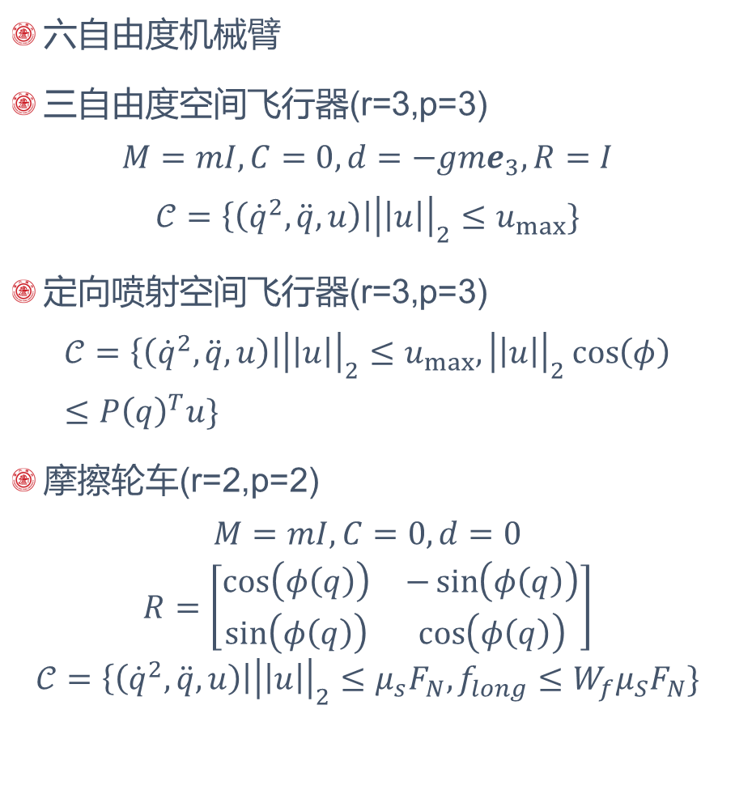
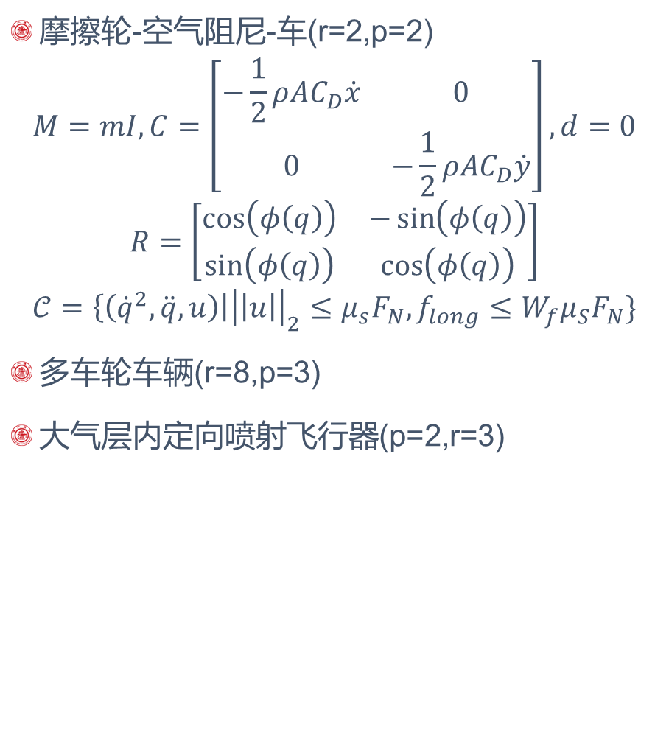
论文中的环境及对应约束
六自由度机械臂
三自由度空间飞行器(r=3,p=3)
$$M=mI, C=0,d=−gme_{3}, R=I$$
$$𝒞=\left\{\left({\dot{q}}^{2},\ddot{q},u\right)\right|{\left|\left|u\right|\right|}_{2}≤u_{max}\}$$
定向喷射空间飞行器(r=3,p=3)
$$𝒞=\left\{\left({\dot{q}}^{2},\ddot{q},u\right)\right|{\left|\left|u\right|\right|}_{2}≤u_{max},{\left|\left|u\right|\right|}_{2}\cos\left(φ\right)≤P{\left(q\right)}^{T}u\}$$
摩擦轮车(r=2,p=2)
$$M=mI,C=0,d=0$$
$$R=\left[\begin{matrix}\cos\left(φ\left(q\right)\right) & −\sin\left(φ\left(q\right)\right) \\ \sin\left(φ\left(q\right)\right) & \cos\left(φ\left(q\right)\right)\end{matrix}\right]$$
$$𝒞=\left\{\left({\dot{q}}^{2},\ddot{q},u\right)\right|{\left|\left|u\right|\right|}_{2}≤μ_{s}F_{N}, f_{long}≤W_{f}μ_{S}F_{N}\}$$
摩擦轮-空气阻尼-车(r=2,p=2)
$$M=mI,C=\left[\begin{matrix}−\frac{1}{2}ρAC_{D}\dot{x} & 0 \\ 0 & −\frac{1}{2}ρAC_{D}\dot{y}\end{matrix}\right],d=0$$
$$R=\left[\begin{matrix}\cos\left(φ\left(q\right)\right) & −\sin\left(φ\left(q\right)\right) \\ \sin\left(φ\left(q\right)\right) & \cos\left(φ\left(q\right)\right)\end{matrix}\right]$$
$$𝒞=\left\{\left({\dot{q}}^{2},\ddot{q},u\right)\right|{\left|\left|u\right|\right|}_{2}≤μ_{s}F_{N}, f_{long}≤W_{f}μ_{S}F_{N}\}$$
多车轮车辆(r=8,p=3)
大气层内定向喷射飞行器(p=2,r=3)

Slide 18
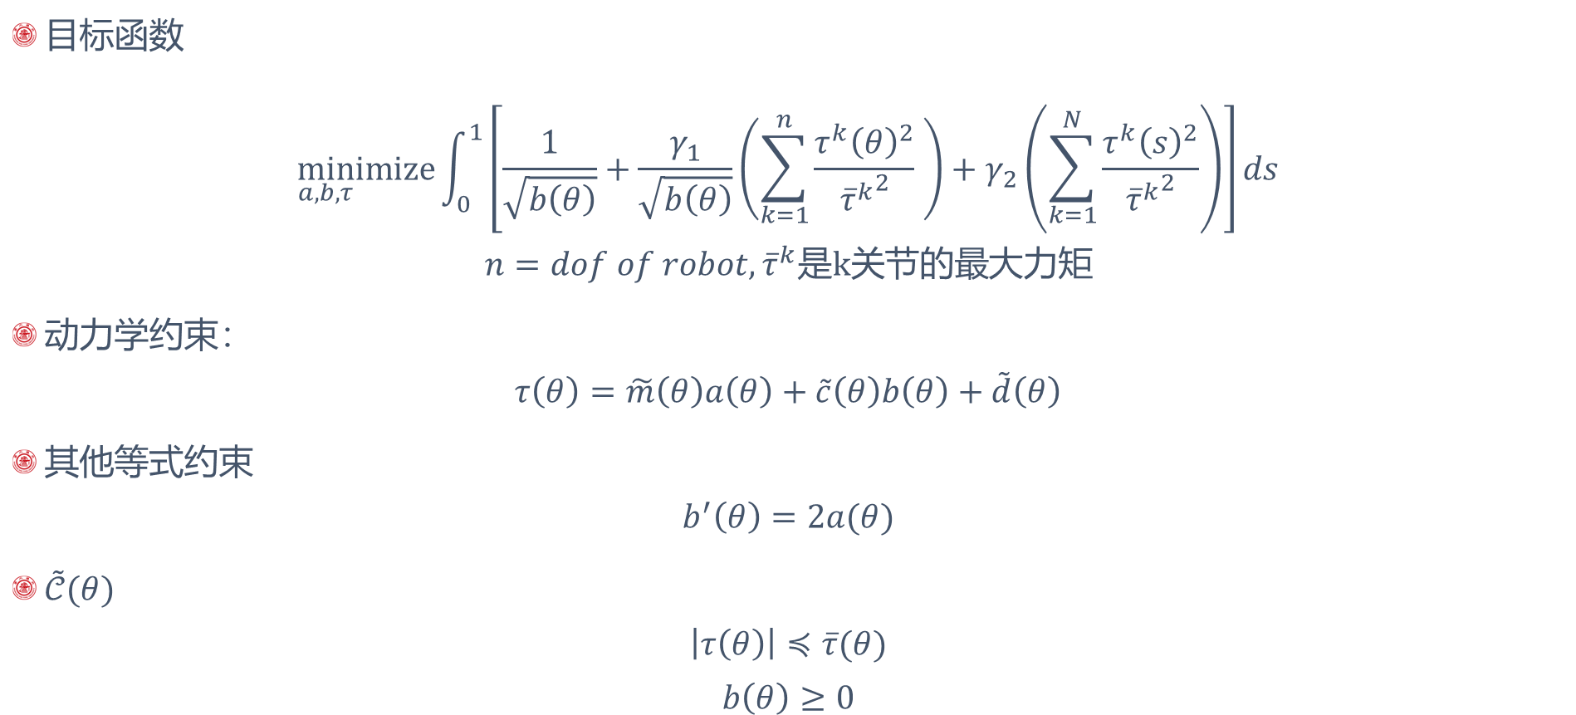
实例：六自由度机械臂（约束）
目标函数
$$\min_{a,b,τ}imize{\int_{0}^{1}{\left[\frac{1}{\sqrt{b\left(θ\right)}}+\frac{γ_{1}}{\sqrt{b\left(θ\right)}}\left(\sum_{k=1}^{n}{\frac{τ^{k}{\left(θ\right)}^{2}}{{{\overline{τ}}^{k}}^{2}} }\right)+γ_{2}\left(\sum_{k=1}^{N}{\frac{τ^{k}{\left(s\right)}^{2}}{{{\overline{τ}}^{k}}^{2}}}\right)\right]ds}}$$
$$n=dof of robot, {\overline{τ}}^{k}是k关节的最大力矩$$
动力学约束：
$$τ\left(θ\right)=\tilde{m}\left(θ\right)a\left(θ\right)+\tilde{c}\left(θ\right)b\left(θ\right)+\tilde{d}\left(θ\right)$$
其他等式约束
$$b^{′}\left(θ\right)=2a(θ)$$
$\tilde{𝒞}(θ)$
$$\left|τ\left(θ\right)\right|≼\overline{τ}(θ)$$
$$b\left(θ\right)≥0$$
*Time-Optimal Path Tracking for Robots: A Convex Optimization Approach

Slide 19
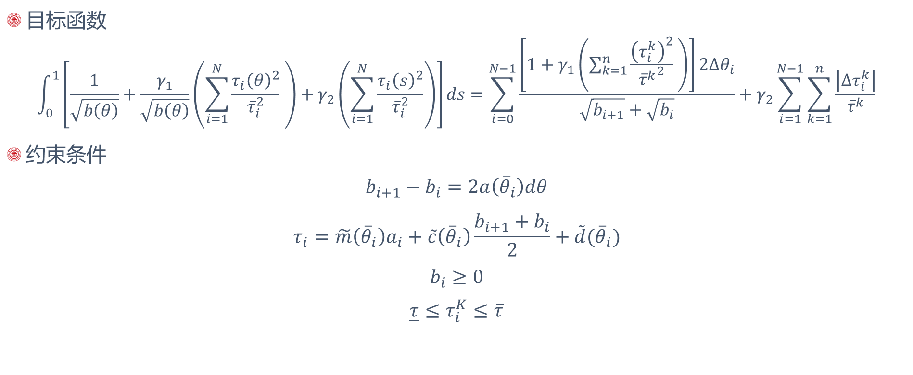
实例：六自由度机械臂（离散化）
目标函数
$$\int_{0}^{1}{\left[\frac{1}{\sqrt{b\left(θ\right)}}+\frac{γ_{1}}{\sqrt{b\left(θ\right)}}\left(\sum_{i=1}^{N}{\frac{τ_{i}{\left(θ\right)}^{2}}{{\overline{τ}}_{i}^{2}} }\right)+γ_{2}\left(\sum_{i=1}^{N}{\frac{τ_{i}{\left(s\right)}^{2}}{{\overline{τ}}_{i}^{2}}}\right)\right]ds=\sum_{i=0}^{N−1}{\frac{\left[1+γ_{1}\left(\sum_{k=1}^{n}{\frac{{\left(τ_{i}^{k}\right)}^{2}}{{{\overline{τ}}^{k}}^{2}} }\right)\right]2Δθ_{i}}{\sqrt{b_{i+1}}+\sqrt{b_{i}}}}+γ_{2}\sum_{i=1}^{N−1}{\sum_{k=1}^{n}{\frac{\left|Δτ_{i}^{k}\right|}{{\overline{τ}}^{k}}}}}$$
约束条件
$$b_{i+1}−b_{i}=2a\left({\overline{θ}}_{i}\right)dθ$$
$$τ_{i}=\tilde{m}\left({\overline{θ}}_{i}\right)a_{i}+\tilde{c}\left({\overline{θ}}_{i}\right)\frac{b_{i+1}+b_{i}}{2}+\tilde{d}({\overline{θ}}_{i})$$
$$b_{i}≥0$$
$$\underline{τ}≤τ_{i}^{K}≤\overline{τ}$$

Slide 20
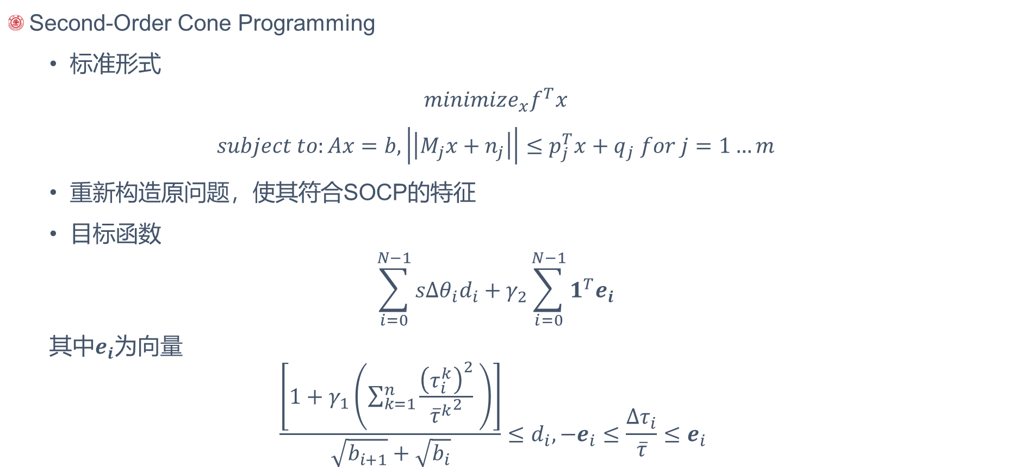
实例：六自由度机械臂 (SOCP)
Second-Order Cone Programming
标准形式
$$minimize_{x}f^{T}x$$
$$subject to:Ax=b,\left|\left|M_{j}x+n_{j}\right|\right|≤p_{j}^{T}x+q_{j} for j=1…m$$
重新构造原问题，使其符合SOCP的特征
目标函数
$$\sum_{i=0}^{N−1}{sΔθ_{i}d_{i}}+γ_{2}\sum_{i=0}^{N−1}{1^{T}e_{i}}$$
其中$e_{i}$为向量
$${\frac{\left[1+γ_{1}\left(\sum_{k=1}^{n}{\frac{{\left(τ_{i}^{k}\right)}^{2}}{{{\overline{τ}}^{k}}^{2}} }\right)\right]}{\sqrt{b_{i+1}}+\sqrt{b_{i}}}≤d}_{i},−e_{i}≤\frac{Δτ_{i}}{\overline{τ}}≤e_{i}$$

Slide 21
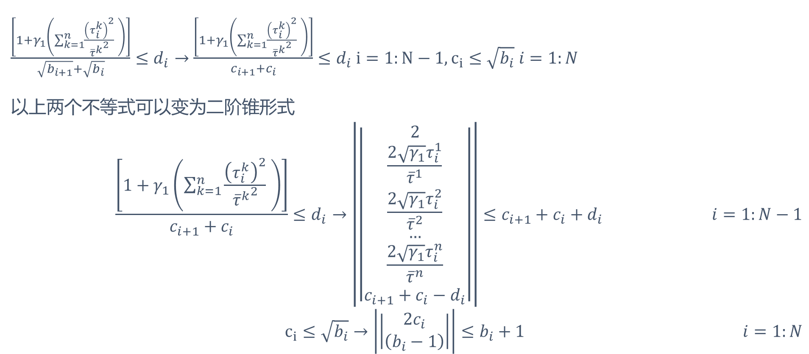
实例：六自由度机械臂 (SOCP)
${\frac{\left[1+γ_{1}\left(\sum_{k=1}^{n}{\frac{{\left(τ_{i}^{k}\right)}^{2}}{{{\overline{τ}}^{k}}^{2}} }\right)\right]}{\sqrt{b_{i+1}}+\sqrt{b_{i}}}≤d}_{i}→$ ${\frac{\left[1+γ_{1}\left(\sum_{k=1}^{n}{\frac{{\left(τ_{i}^{k}\right)}^{2}}{{{\overline{τ}}^{k}}^{2}} }\right)\right]}{c_{i+1}+c_{i}}≤d}_{i} i=1:N−1,c_{i}≤\sqrt{b_{i}} i=1:N$
以上两个不等式可以变为二阶锥形式
$$\begin{aligned}{\frac{\left[1+γ_{1}\left(\sum_{k=1}^{n}{\frac{{\left(τ_{i}^{k}\right)}^{2}}{{{\overline{τ}}^{k}}^{2}} }\right)\right]}{c_{i+1}+c_{i}}≤d}_{i}→\left|\left|\begin{matrix}2 \\ \frac{2\sqrt{γ_{1}}τ_{i}^{1}}{{\overline{τ}}^{1}} \\ \frac{2\sqrt{γ_{1}}τ_{i}^{2}}{{\overline{τ}}^{2}} \\ … \\ \frac{2\sqrt{γ_{1}}τ_{i}^{n}}{{\overline{τ}}^{n}} \\ c_{i+1}+c_{i}−d_{i}\end{matrix}\right|\right|≤c_{i+1}+c_{i}+d_{i} \#i=1:N−1\end{aligned}$$
$$\begin{aligned}c_{i}≤\sqrt{b_{i}}→\left|\left|\begin{matrix}2c_{i} \\ \left(b_{i}−1\right)\end{matrix}\right|\right|≤b_{i}+1 \#i=1:N\end{aligned}$$

Slide 22
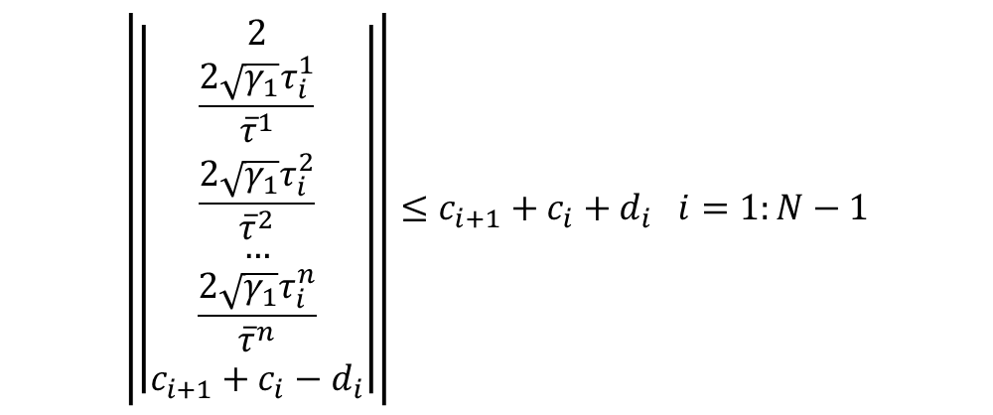
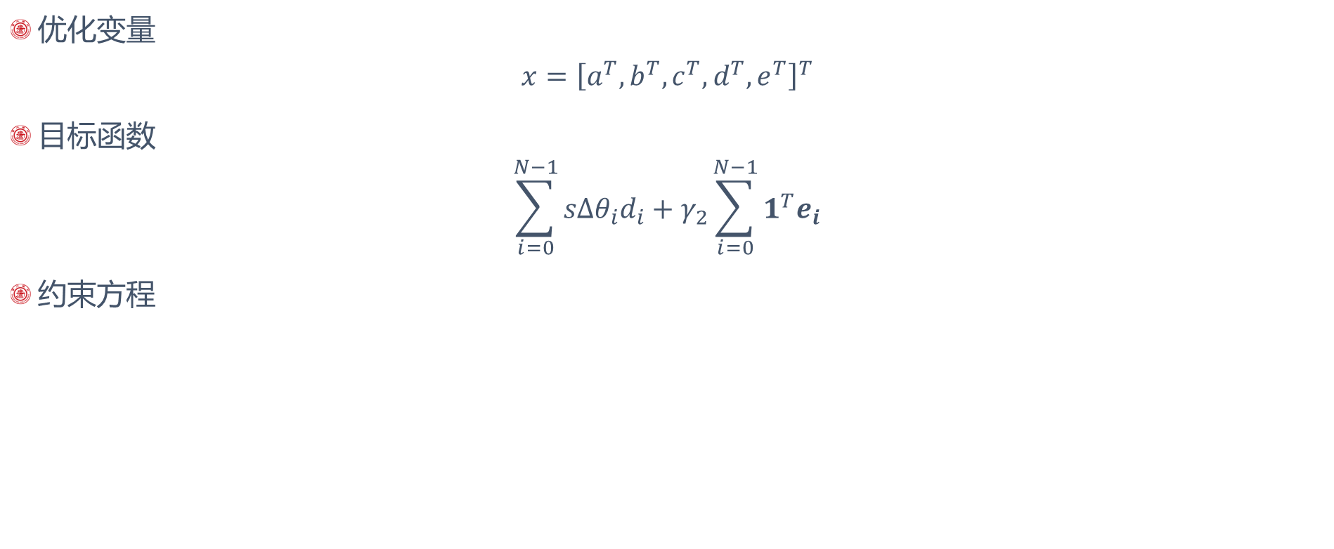
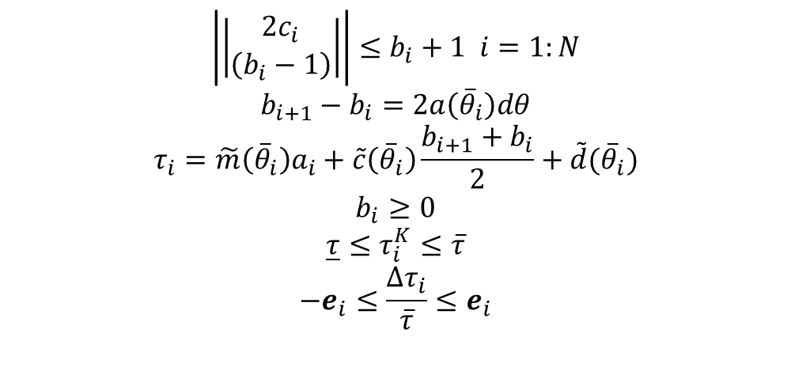
实例：六自由度机械臂 (SOCP)
优化变量
$$x={\left[a^{T},b^{T},c^{T},d^{T},e^{T}\right]}^{T}$$
目标函数
$$\sum_{i=0}^{N−1}{sΔθ_{i}d_{i}}+γ_{2}\sum_{i=0}^{N−1}{1^{T}e_{i}}$$
约束方程
$$\left|\left|\begin{matrix}2 \\ \frac{2\sqrt{γ_{1}}τ_{i}^{1}}{{\overline{τ}}^{1}} \\ \frac{2\sqrt{γ_{1}}τ_{i}^{2}}{{\overline{τ}}^{2}} \\ … \\ \frac{2\sqrt{γ_{1}}τ_{i}^{n}}{{\overline{τ}}^{n}} \\ c_{i+1}+c_{i}−d_{i}\end{matrix}\right|\right|≤c_{i+1}+c_{i}+d_{i} i=1:N−1$$
$$\left|\left|\begin{matrix}2c_{i} \\ \left(b_{i}−1\right)\end{matrix}\right|\right|≤b_{i}+1 i=1:N$$
$$b_{i+1}−b_{i}=2a\left({\overline{θ}}_{i}\right)dθ$$
$$τ_{i}=\tilde{m}\left({\overline{θ}}_{i}\right)a_{i}+\tilde{c}\left({\overline{θ}}_{i}\right)\frac{b_{i+1}+b_{i}}{2}+\tilde{d}({\overline{θ}}_{i})$$
$$b_{i}≥0$$
$$\underline{τ}≤τ_{i}^{K}≤\overline{τ}$$
$$−e_{i}≤\frac{Δτ_{i}}{\overline{τ}}≤e_{i}$$

Slide 23
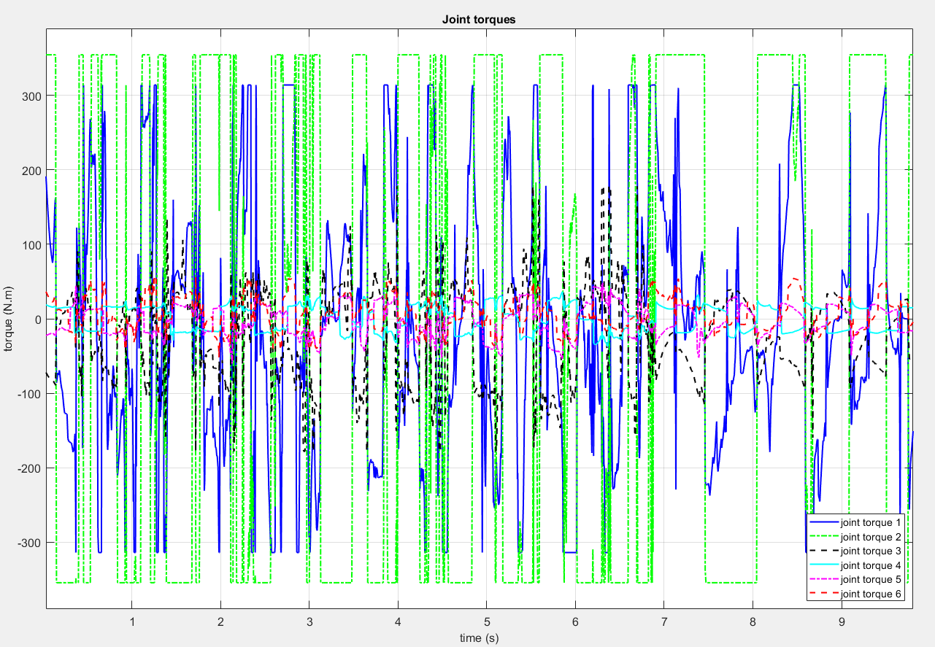
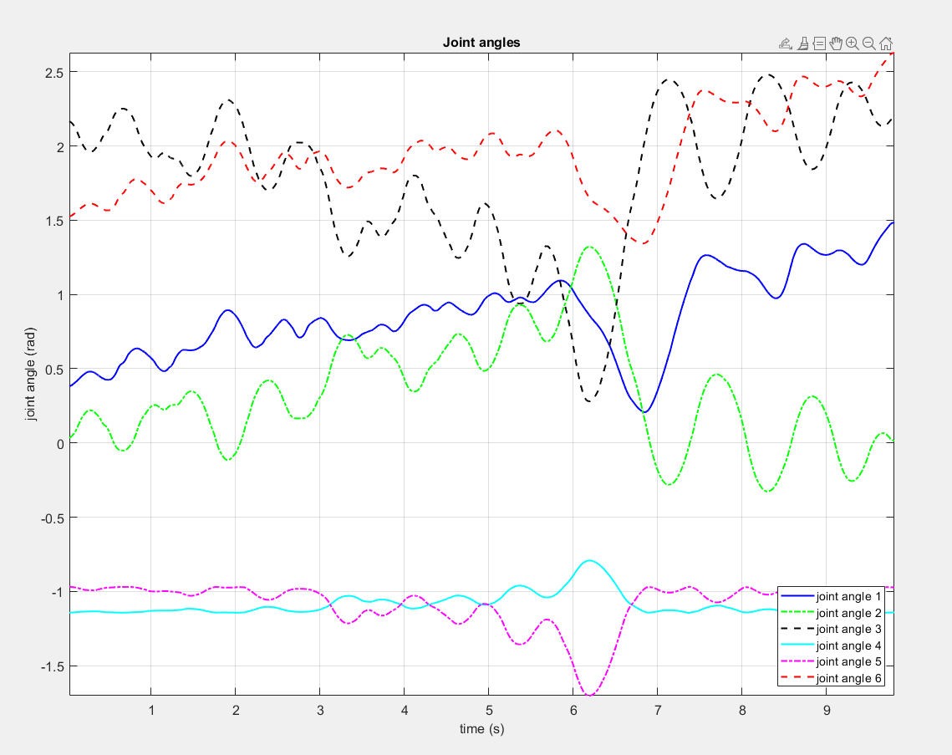
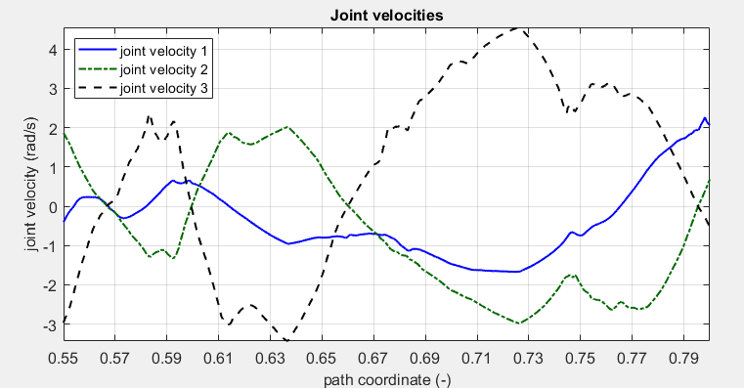
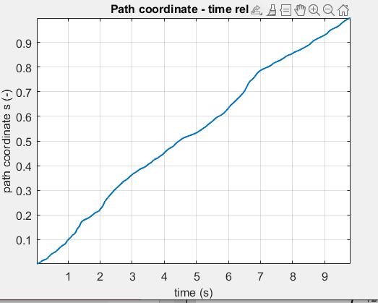
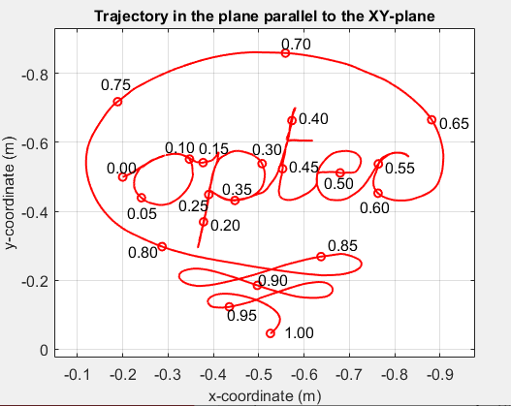
实例：六自由度机械臂 (结果）
原轨迹存在很多折返点
导致加速度剧烈变化
T=9.806531502897540 solvetime = 31.798$γ_{1}=0, γ_{2}=0$

Slide 24
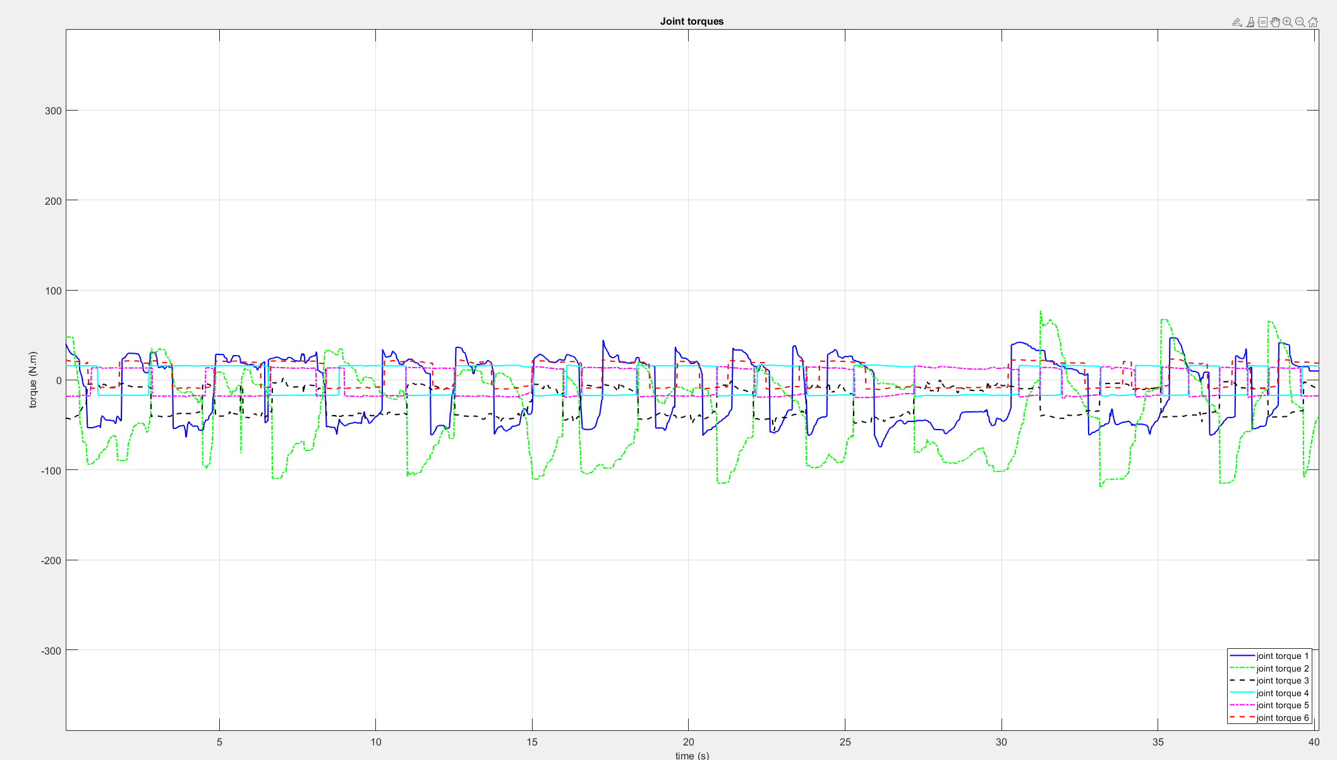
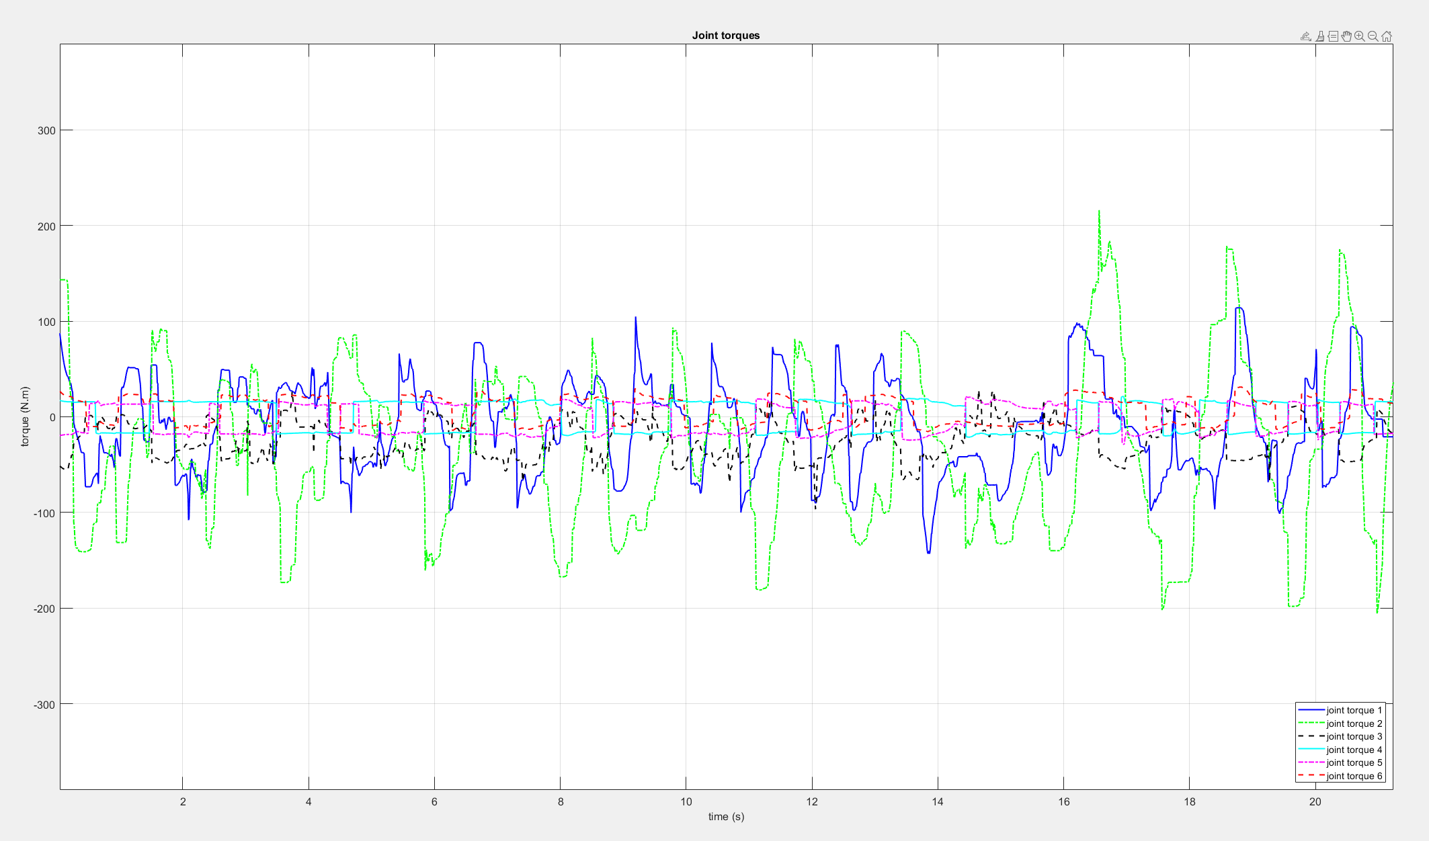
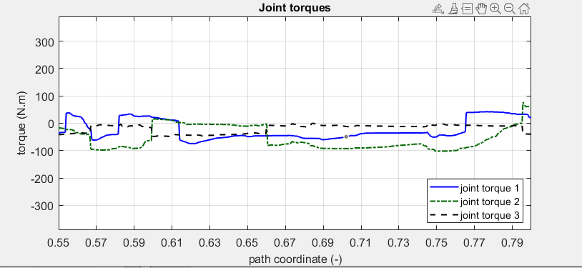
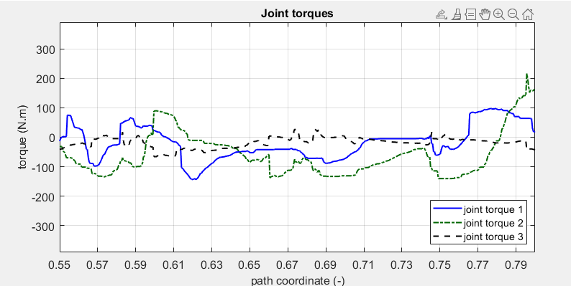


实例：六自由度机械臂 (结果）
$$γ_{1}=0,γ2=0.\text{545559478116852}$$
$$γ_{1}=0,γ2=\text{0.078475997035146}$$
T=40.155035487603456 solve time = 424s
T=21.237s Solve-time=373.785s

Slide 25
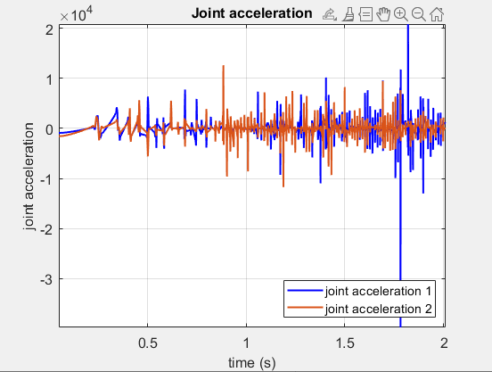
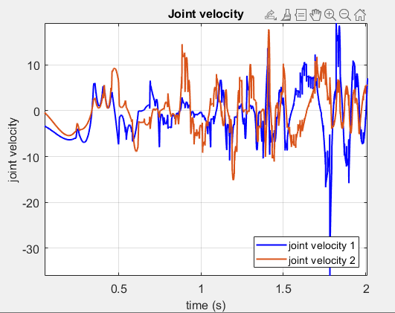
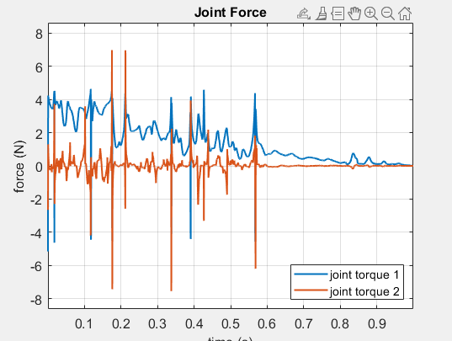
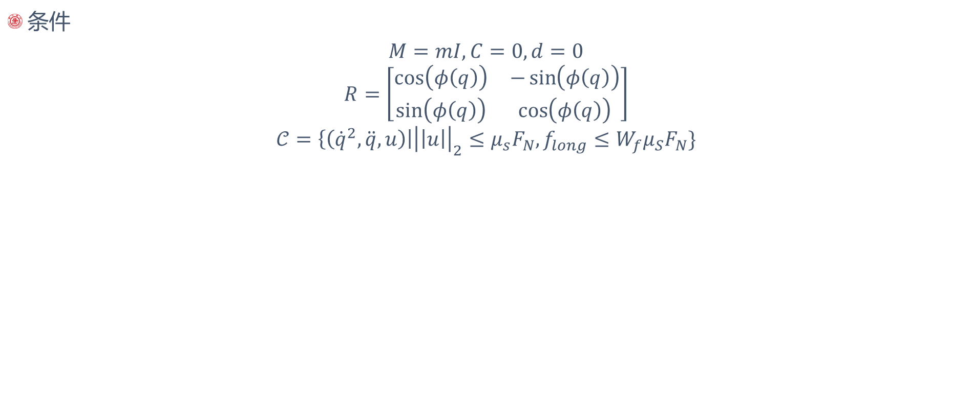
实例：摩擦约束汽车(Interior Point Method)
条件
$$M=mI,C=0,d=0$$
$$R=\left[\begin{matrix}\cos\left(φ\left(q\right)\right) & −\sin\left(φ\left(q\right)\right) \\ \sin\left(φ\left(q\right)\right) & \cos\left(φ\left(q\right)\right)\end{matrix}\right]$$
$$𝒞=\left\{\left({\dot{q}}^{2},\ddot{q},u\right)\right|{\left|\left|u\right|\right|}_{2}≤μ_{s}F_{N}, f_{long}≤W_{f}μ_{S}F_{N}\}$$
Solve time=18s

Slide 26
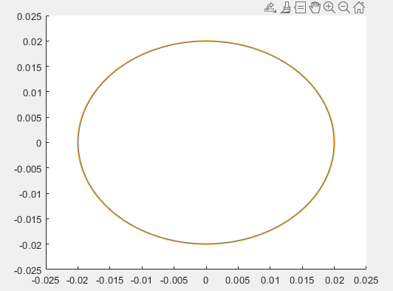
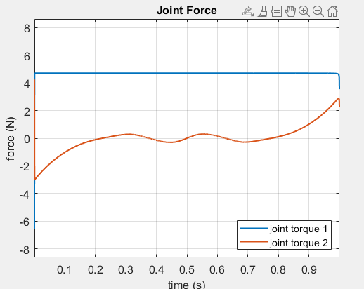



实例：摩擦约束汽车(Interior Point Method)
圆轨迹
力曲线
力曲线

Slide 27
参考文献
Lipp, T., & Boyd, S. (2014). Minimum-time speed optimisation over a fixed path. International Journal of Control, 87(6), 1297–1311. https://doi.org/10.1080/00207179.2013.875224
Verscheure, D., Demeulenaere, B., Swevers, J., De Schutter, J., & Diehl, M. (2009). Time-optimal path tracking for robots: A convex optimization approach. IEEE Transactions on Automatic Control, 54(10), 2318–2327. https://doi.org/10.1109/TAC.2009.2028959
Vavasis, S. (1998). Convex Optimization. https://doi.org/10.1201/9781420049503-c34

Slide 28
谢谢

